Slide 1
A precise extraction of the induced polarization in ⁴He(e,e’p)³H from E03-104
Simona Malace
University of South Carolina
Outline
Why we need it?
How we do it?
How precise is it at this point?

Slide 2
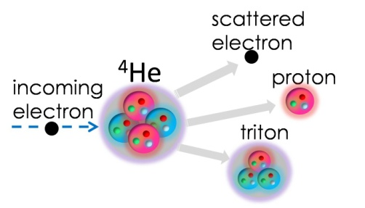
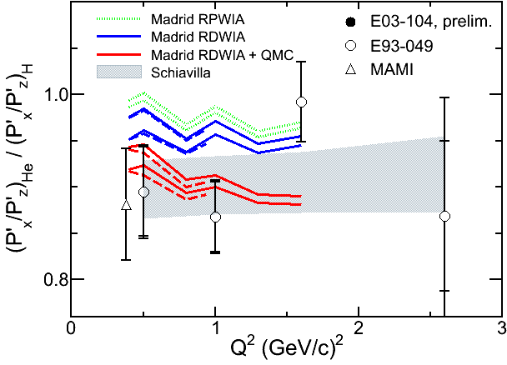
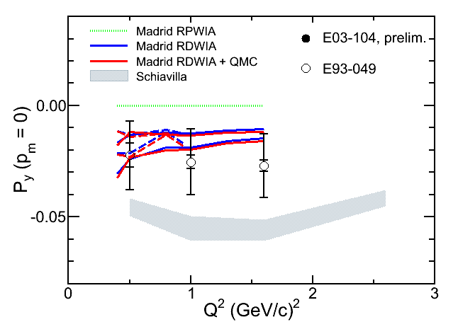
A precise extraction of…
E93-049 in Hall A at JLab
Why?
Quasielstic scattering off ⁴He using the polarization transfer technique
- elastic => P’_{x}/P’_{z} ~ G_{E}/G_{M}
- quasielastic => P’_{x}/P’_{z} sensitive to G_{E}/G_{M}
- P_{y} measure of final-state interactions (FSI)
lalalalalalala
lalalalalalala
(P’_{x}/P’_{z})_{in-medium}/ (P’_{x}/P’_{z}) _{free} well described by conventional + unconventional (Madrid) OR conventional only nuclear medium effects (Schiavilla et al.)
Quantitatively, the two models predict different results for P_{y}

Slide 3
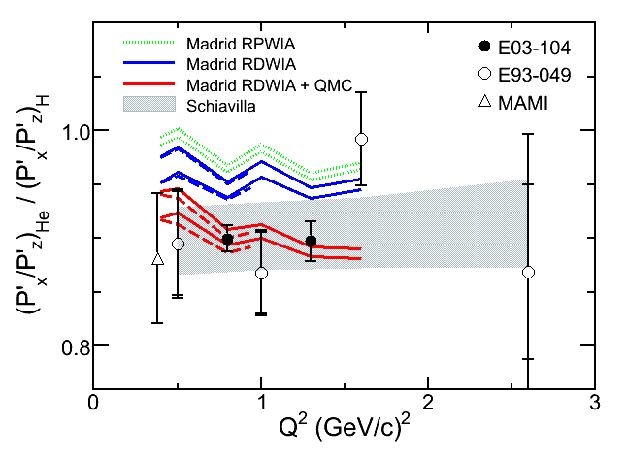
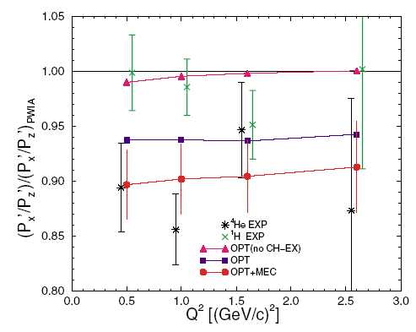
A precise extraction of…
Nuclear Medium Effects: Madrid vs Schiavilla et al.
Why?
RDWIA + QMC:
Relativistic treatment to: initial bound/final outgoing proton WF, current operator; MEC not included
- FSI: relativistic optical potentials (central + spin dependent )
Nuclear density-dependent proton
form factors via QMC model
Schiavilla et al.:
Variational wave functions for the bound three- and four-nucleon systems + nonrelativistic MEC
FSI via optical potentials with an additional charge-exchange term (largely unconstrained)
Free proton form factors
J. Udias et al., Phys. Rev. Lett. 83, 5451 (1999)
R. Schiavilla et al., Phys. Rev. Lett. 94, 072303 (2005)
Relativistic treatment +FSI: reduction by ~ 4 %
Density dependent form factors: reduction by ~ 6%
- FSI, no CH-EX: reduction by ~ 0.5 %
FSI + CH-EX: reduction by ~ 5.5 %
MEC: reduction by ~ 4%

Slide 4
A precise extraction of…
Extraction of the induced polarization from E03-104
How?
Instrumental asymmetries complicate the extraction of induced polarization and are typically caused by:
- detector inefficiencies
- detector misalignments
- limited acceptance of the detector
Make sure the detector is equally efficient throughout the acceptance
Use straight-through events (no graphite block in FPP ) to determine the misalignment coefficients
Use a “cone test” : the “basis of the cone” has to fit within the active area of the FPP chambers
E03-104: data on both ⁴He and H (uniform coverage)
=> in ⁴He – H some false asymmetries cancel
=> use P_{y} in H to estimate the size of false asymmetries

Slide 5
A precise extraction of…
Detector Inefficiencies
How?
FPP chambers inefficiencies
Problem: dead wires in some planes => no track reconstructed by standard tracking algorithm
Solution: relax the algorithm by requiring less hits for track reconstruction
Standard tracking:
at least 1 hit in CH3/CH4 & at least 3 hits in total
tries to resolve the left-right ambiguities
standard
v
relaxed
u
standard
relaxed
Fourier Coefficient
u (cm)
Relaxed tracking: at least 1 hit in CH3 or CH4
- if 1 hit in each chamber => track
if 1 hit just in one of the chambers => hit + pC vertex = track

Slide 6
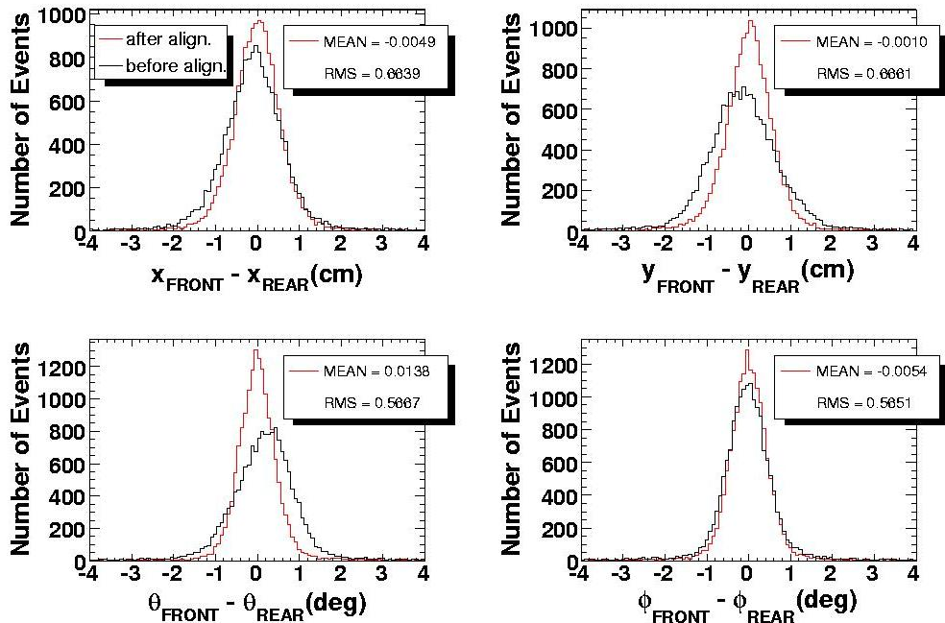
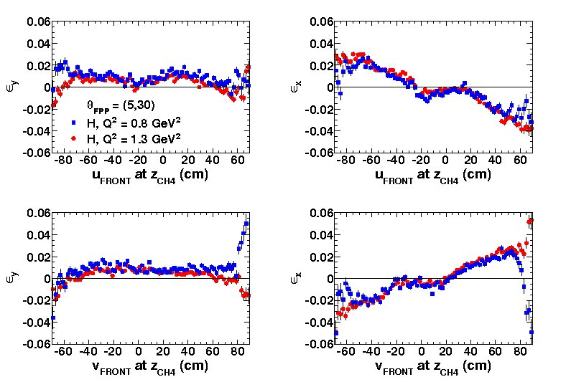
A precise extraction of…
Detector Misalignments
How?
FPP chambers misalignments: standard alignment
Problem: physical misalignments of FRONT and REAR FPP chambers => FRONT and REAR track misalignment and incorrect reconstruction of ϑ_{FPP} and φ_{FPP}
Solution: use straight-through events to align the FRONT and REAR
Relaxed tracking +
Standard alignment + Cone test
Standard alignment
Strong asymmetries for H across the acceptance => false asymmetries
To minimize false asymmetries we thought of a revised method for alignment

Slide 7
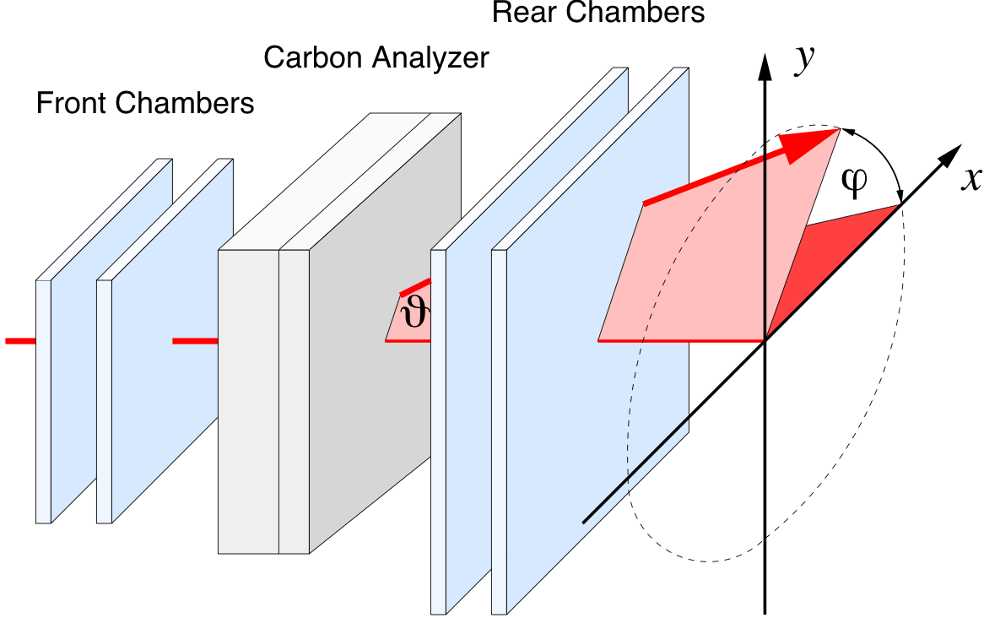
A precise extraction of…
Alignment Method: Revised
How?
FPP chambers misalignments: comparison standard-revised alignment
Standard Alignment: plane dependent correction
Align tracks in x, y: VDC-FRONT & FRONT-REAR
Revised Alignment: plane and wire dependent correction
Align tracks in u, v: VDC-FRONT & FRONT-REAR
Revised Alignment: Procedure
Select a “clean” sample of events and determine
Align VDC-FRONT & FRONT-REAR tracks in u and v

Slide 8
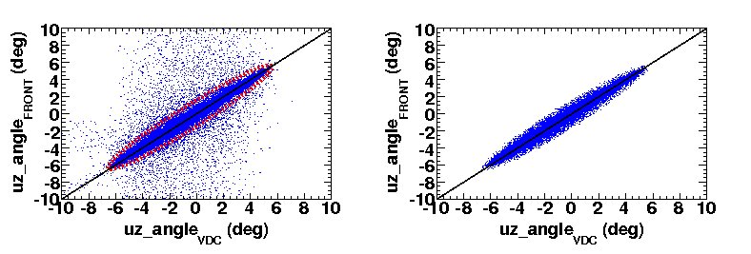
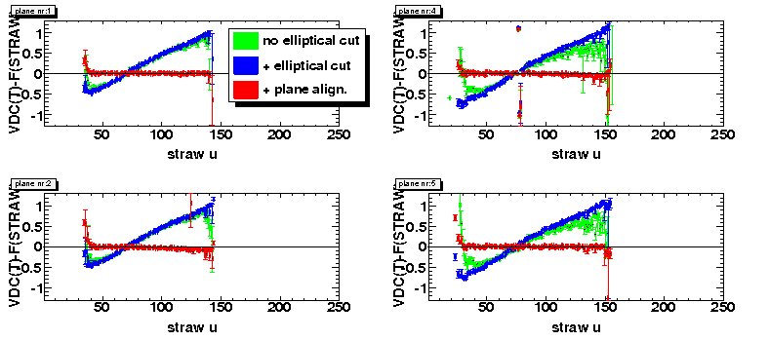
A precise extraction of…
Alignment Method: Revised
How?
Select a “clean” sample of events and determine
this is used for alignment …
before correction
after
correction

Slide 9
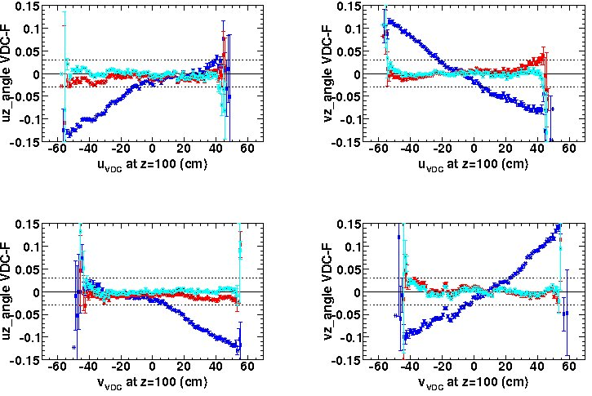
A precise extraction of…
Alignment Method: Revised
How?
Align tracks in u and v
No alignment
Plane alignment
Plane + track alignment
VDC-FRONT alignment

Slide 10
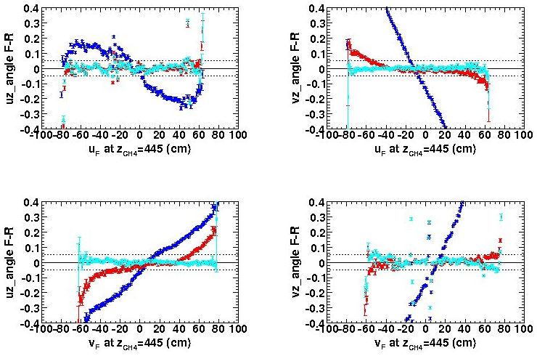
A precise extraction of…
Alignment Method: Revised
How?
Align tracks in u and v
No alignment
Plane alignment
Plane + track alignment
FRONT-REAR alignment

Slide 11
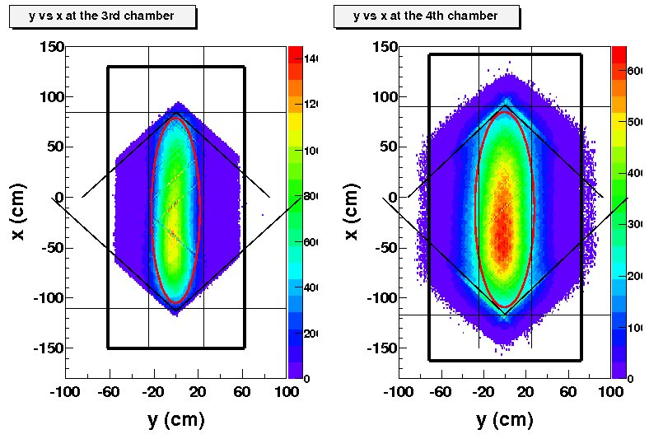
A precise extraction of…
Cone Test and Cone-Test Cuts
How?
Cuts to delimit the region where alignment coefficients are constrained
Elliptical cut to select the safe active region to be used

Slide 12
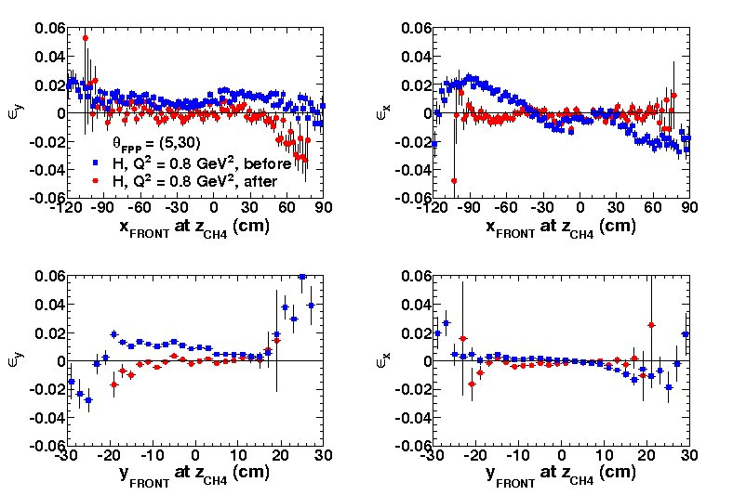
A precise extraction of…
Fourier Coefficients
How precise?
After new alignment and news cone test cuts: reduction of false asymmetries
reduction by factor of 4
Not perfect so we still rely on subtraction of P_{y}(H) from P_{y}(He) to cancel some of the remaining false asymmetries

Slide 13
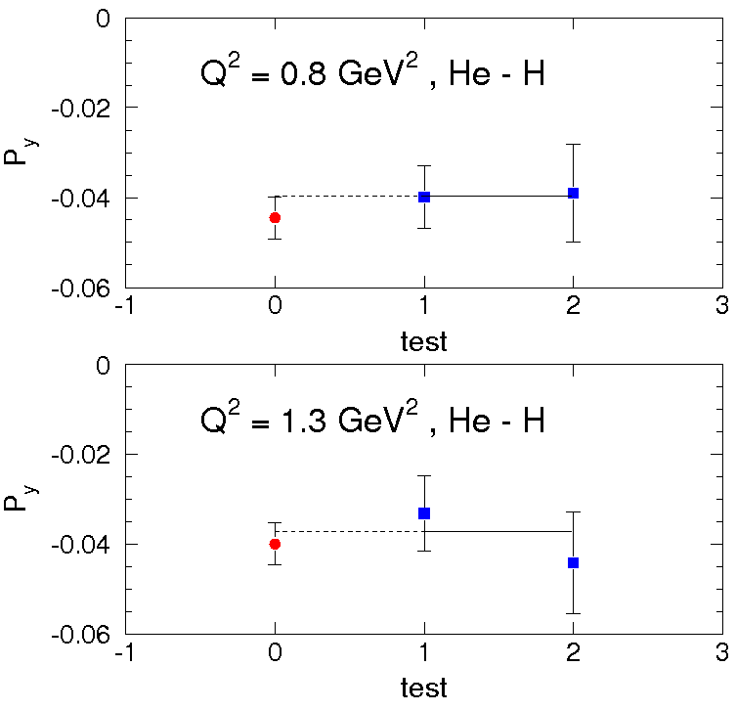
A precise extraction of…
P_{y}: Systematic Checks
How precise?

Slide 14
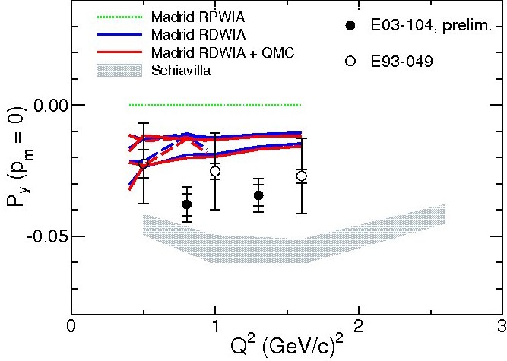
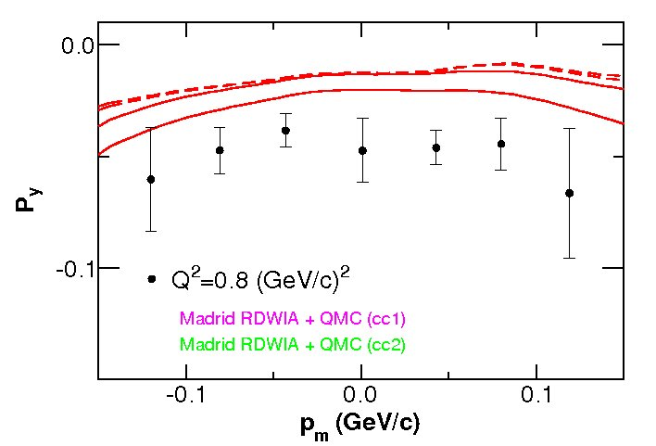
A precise extraction of…
P_{y}: Preliminary Results
How precise?
Greatly reduced systematic uncertainties for latest data: preliminary upper limit for systematic uncertainty 0.005, 4 times smaller than for E03-049
blanlablablabal
Neither calculation agrees presently to the latest, more precise data

Slide 15
Summary
To extract the induced polarization with great accuracy:
revised the tracking algorithm to serve our needs
revised the alignment method (with appropriate cuts to eliminate background) for a more precise alignment
Greatly reduced systematic uncertainties for E03-104 data: preliminary upper limit for systematic uncertainty 0.005, 4 times smaller than for E03-049
Neither calculation agrees presently to the latest, more precise data
Draft of the P_{y} paper no later than March 2010

Slide 16
“What if” slides

Slide 17
A precise extraction of…
Nuclear Medium Effects
Why?
Nuclear corrections beyond the impulse approximation: conventional and unconventional
Medium modifications of the nucleon form factor
P^{μ} _{Ν}
P^{μ}_{A-1}
Coulomb distortion
final state interactions
P^{μ}_{A}
off-shell effects
many-body currents
Difficult to disentangle: need exhaustive knowledge of the conventional effects to reliably find signature of unconventional effects

Slide 18
Alignment Method: Revised
Determine Polynomial(wire) for each plane
Project VDC track to each palne of FRONT chamber and fit position difference: VDC(track)-FRONT(wire)
Project FRONT track to each palne of REAR chamber and fit position difference: FRONT(track)-REAR(wire)
y
u plane
v plane
x
z
position_u(v)_new = position_u(v)_old + Polynomial(wire)

Slide 19
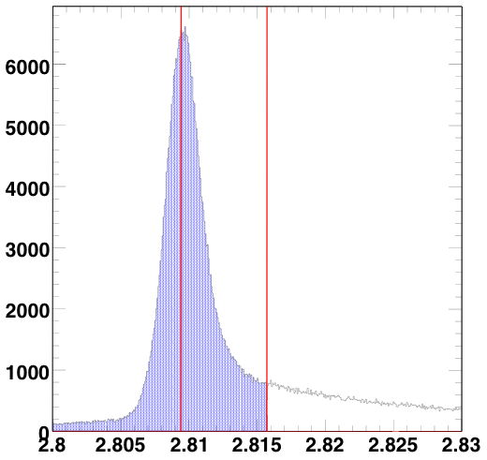
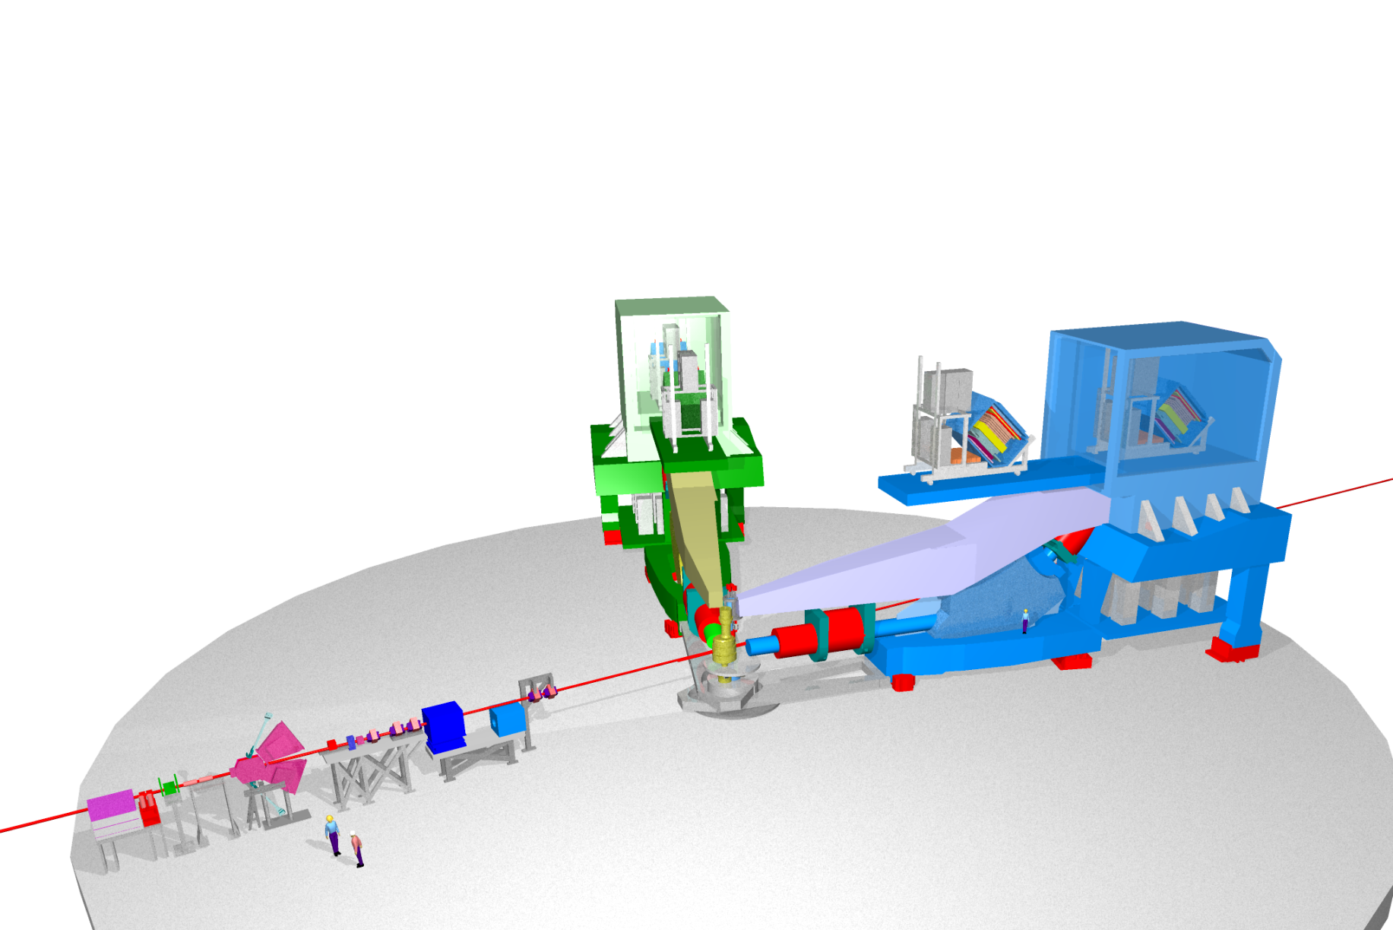
E03-104 in Hall A at JLab
m(³H)
Focal Plane Polarimeter (FPP)
3-body break-up
region
Proton arm
Missing Mass (GeV)
Electron arm
Q² (GeV²)
E93-049
0.5, 1.0, 2.6
E03-104
0.8, 1.3
Polarized Electron Beam
Target Chamber:
¹H and ⁴He targets
Extract with greater accuracy (P’_{x}/P’_{z})_{He}/ (P’_{x}/P’_{z})_{H} and P_{y}

Slide 20
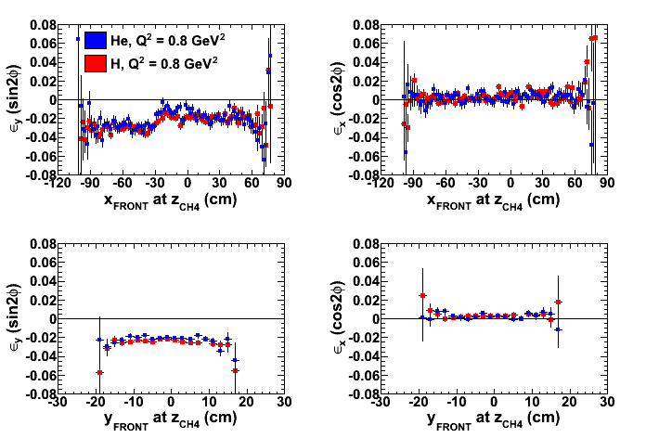
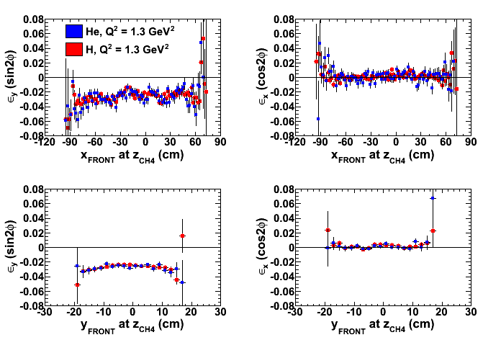

Slide 21
